Slide 1


In the name of God
Theory of Quantum walk
And introduce Quantum walk search
By: Hayede Zarei

Slide 2
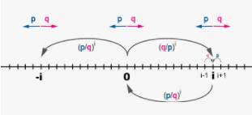
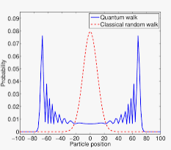
Classical walk
Random walk
Quantum walk

Slide 3
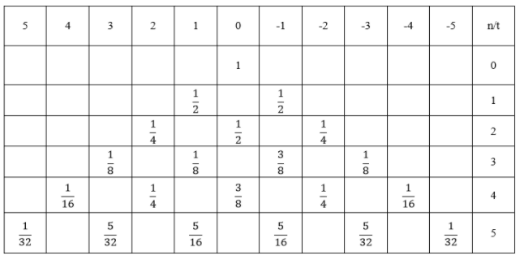
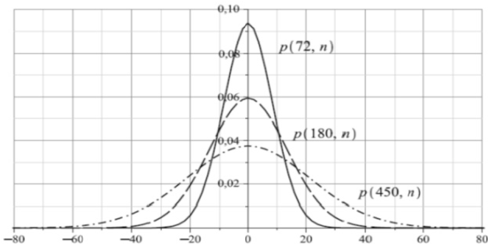
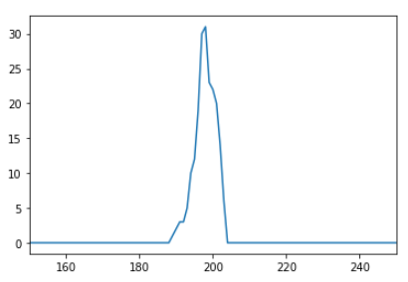
Theorical
Classical walk
Theorical
Experimental
Experimental
Conclusion

Slide 4


a "coin flip" operator
Quantum walk
a conditional shift operator
The position of the system is introduced by |𝑛⟩ in a Hilbert space 𝐻𝑝, where {|𝑛⟩∈𝑧}.
The direction of the movements is defined in another Hilbert space called 𝐻𝑐 (coin space).

Slide 5
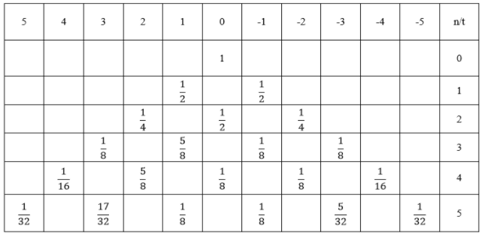

Slide 6
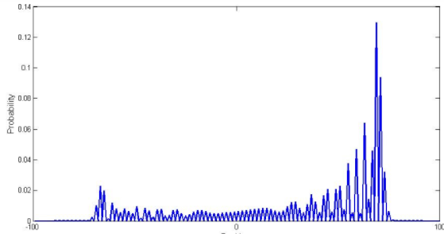
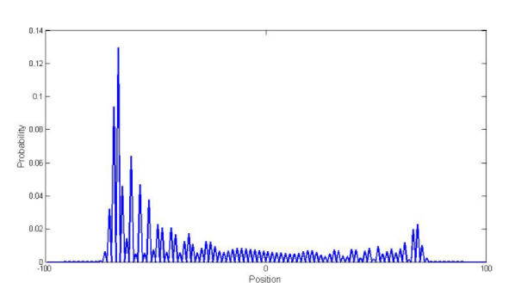
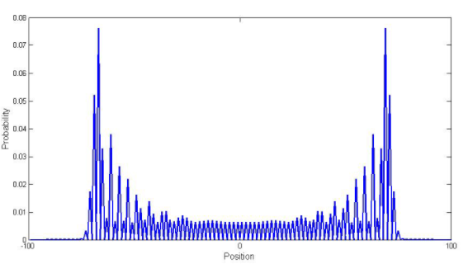

Normalized with Hadamard operator :
The probability distribution of the system after Applying
100 times Hadamard for initial state 𝜓0=|00⟩ψ0=|00⟩.
The probability distribution of the system after applying
100 times Hadamard for initial state 𝜓0=|10⟩ψ0=|10⟩.

Slide 7
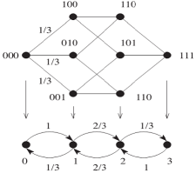
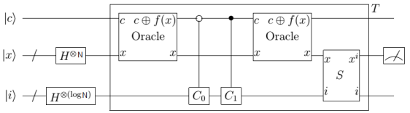
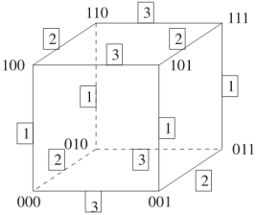
quantum walk search algorithm
Shenvi, Kempe and Whaley
SKW

Slide 8
Thanks for your attention

